Slide 1
A program For Photographers Event
By – Vivek

Slide 2
Introduction
ABC is a company based in Toronto for organizing events, currently it works on a project to organize an event for 5 days for a group of photographers from all over the world.
The company has to put a good program, including a hotel of residence, a hall for meetings, places of landscape to visit, stores for shopping, restaurants and cafes.
So the company’s purpose is to make a list of places of landscape in Toronto, including the nearest restaurants, cafes, and shopping stores for each place.

Slide 3
Data Description
The data used in this project is provided by Foursquare location data.
The data are grouped by landscape area, and each area included the information about this area and all information about restaurants, cafes, and stores which in this area.

Slide 4
01- Import Libraries
import requests # to handle requests
import pandas as pd # for data analsysis
import numpy as np # to handle data in a vectorized manner
from geopy.geocoders import Nominatim # module to convert an address into latitude and longitude values
from IPython.display import Image # libraries for displaying images
from IPython.core.display import HTML # libraries for displaying images
from pandas.io.json import json_normalize # tranforming json file into a pandas dataframe library
import folium # plotting library

Slide 5
02- Define Foursquare Credentials
Credentials:
Foursquare_ID: MKBS33KBHGHJVC1M0PW0RWACML2BFOZWGO2510DRO4WHPQSD
Foursquare_Secret: US0VTVDIKKB253MYPLRG5KOITMAOGXQ2SRNYKL5B1HYQN05M
Version : 20200525

Slide 6
03- Define the city and get its latitude & longitude
city = 'Toronto’
Latitude = 43.6534817
Longitude = -79.3839347

Slide 7
04- Search for Hotels & clean dataframe
Searched Hotels in 500 m radius by using Foursquare API and cleaned the Hotel Dataframe
 | name | categories | address | lat | lng | postalCode | state
0 | Chelsea Hotel | Hotel | 33 Gerrard Street West | 43.658498 | -79.383097 | M5G 1Z4 | ON
1 | Sheraton Centre Toronto Hotel | Hotel | 123 Queen Street West | 43.650594 | -79.384530 | M5H 2M9 | ON
2 | Pantages Hotel & Spa | Hotel | 200 Victoria St | 43.654498 | -79.379035 | NaN | ON
3 | Crew Room Eaton Chelsea Hotel | Hotel | 33 Gerrard Street West | 43.658094 | -79.382711 | NaN | ON
4 | Cosmopolitan Toronto Centre Hotel & Spa | Hotel | 8 Colborne St | 43.649064 | -79.377598 | M5E 1E1 | ON

Slide 8
05- Search for Parks & clean dataframe
Searched Parks in 10000 m radius by using Foursquare API and cleaned the Parks Dataframe
 | name | categories | address | lat | lng | postalCode | state
8 | Queen's Park | Park | University Ave. | 43.663946 | -79.392180 | M5R 2E8 | ON
13 | Trinity Bellwoods Park | Park | 1053 Dundas St. W. | 43.647072 | -79.413756 | M5H 2N2 | ON
16 | Riverdale Park West | Park | 500 Gerrard St. | 43.666048 | -79.360941 | M5A 2H3 | ON
22 | Barbara Hall Park | Park | 519 Church St | 43.666879 | -79.381068 | M4Y 2K9 | ON
25 | Riverdale Park East | Park | 550 Broadview Ave | 43.669951 | -79.355493 | M4K 2P1 | ON

Slide 9
06- Search for Restaurants & clean dataframe
Searched Restaurant in 10000 m radius by using Foursquare API and cleaned the Restaurant Dataframe
 | name | categories | address | lat | lng | postalCode | state
0 | Hemispheres Restaurant & Bistro | American Restaurant | 110 Chestnut Street | 43.654884 | -79.385931 | M5G 1R3 | ON
2 | Victoria's Restaurant | Restaurant | 37 King Street East | 43.649298 | -79.376431 | M5C 1E9 | ON
3 | Rol San Restaurant 龍笙棧 | Dim Sum Restaurant | 323 Spadina Ave. | 43.654318 | -79.398650 | M5T 2E9 | ON
4 | Studio Restaurant | Breakfast Spot | 389 Church St. | 43.661500 | -79.379319 | M5B | ON
5 | Victor Restaurant & Bar | Bar | 30 Mercer Street | 43.645634 | -79.391125 | M5V 1H3 | ON

Slide 10
07- Search for Cafeteria & clean dataframe
Searched Cafeteria in 10000 m radius by using Foursquare API and cleaned the Cafeteria Dataframe
 | name | categories | address | lat | lng | postalCode | state
1 | Stay Cafeteria 慢走 | Asian Restaurant | 388 Spadina Ave | 43.655454 | -79.399163 | ON | M5T 2G5
9 | De La Salle College Cafeteria | College Cafeteria | 131 Farnham Avenue | 43.683003 | -79.397815 | ON | M4V 1H7
19 | Marketeria | Restaurant | 30 Bond St. | 43.653585 | -79.378843 | ON | M5B 1W8
21 | The Hub | College Cafeteria | 350 Victoria St. | 43.658585 | -79.380622 | ON | M5B 2K3
24 | Innis College | Student Center | 2 Sussex Ave | 43.665556 | -79.399298 | ON | M5S 1J5
27 | 6th Floor Cafeteria 12 Concorde Place | Café | 12 Concorde Place | 43.721861 | -79.329339 | ON | m3c 3k7

Slide 11
08- Search for Shopping Stores & clean dataframe
Searched Shopping Stores in 1000 m radius by using Foursquare API and cleaned the Shopping Stores Dataframe
 | name | categories | address | lat | lng | postalCode | state
1 | TD Centre Shopping Concourse | Shopping Mall | 66 Wellington St W | 43.647184 | -79.380932 | M5K 1A1 | ON
2 | CF Toronto Eaton Centre | Shopping Mall | 220 Yonge St | 43.654540 | -79.380677 | M5B 2H1 | ON

Slide 12
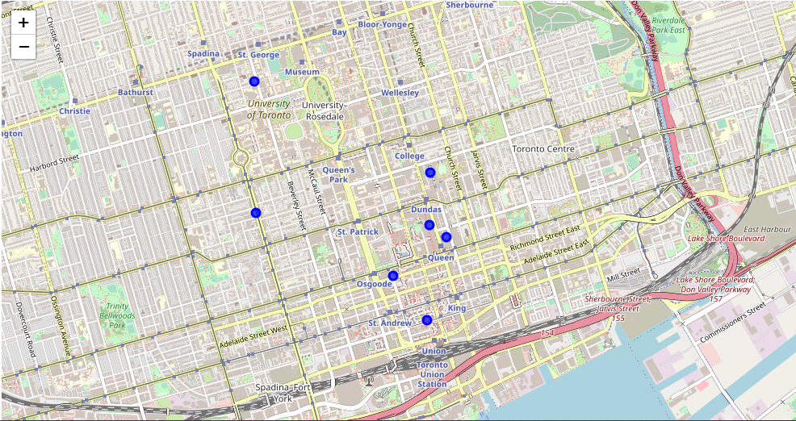
09- Generate map to visualize hotels, shopping stores and Cafeteria and how they cluster together

Slide 13
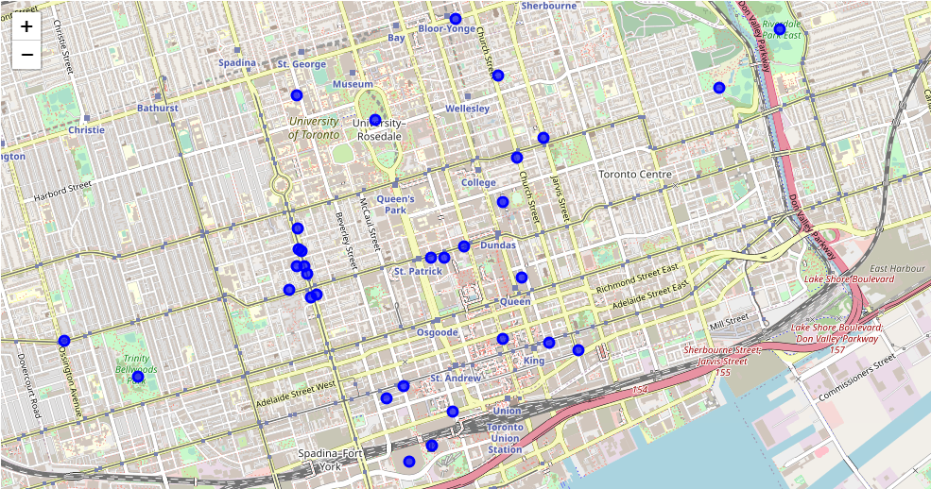
10- Generate map to visualize Park, Restaurant and Cafeteria and how they cluster together

Slide 14
THANK you

